Slide 1
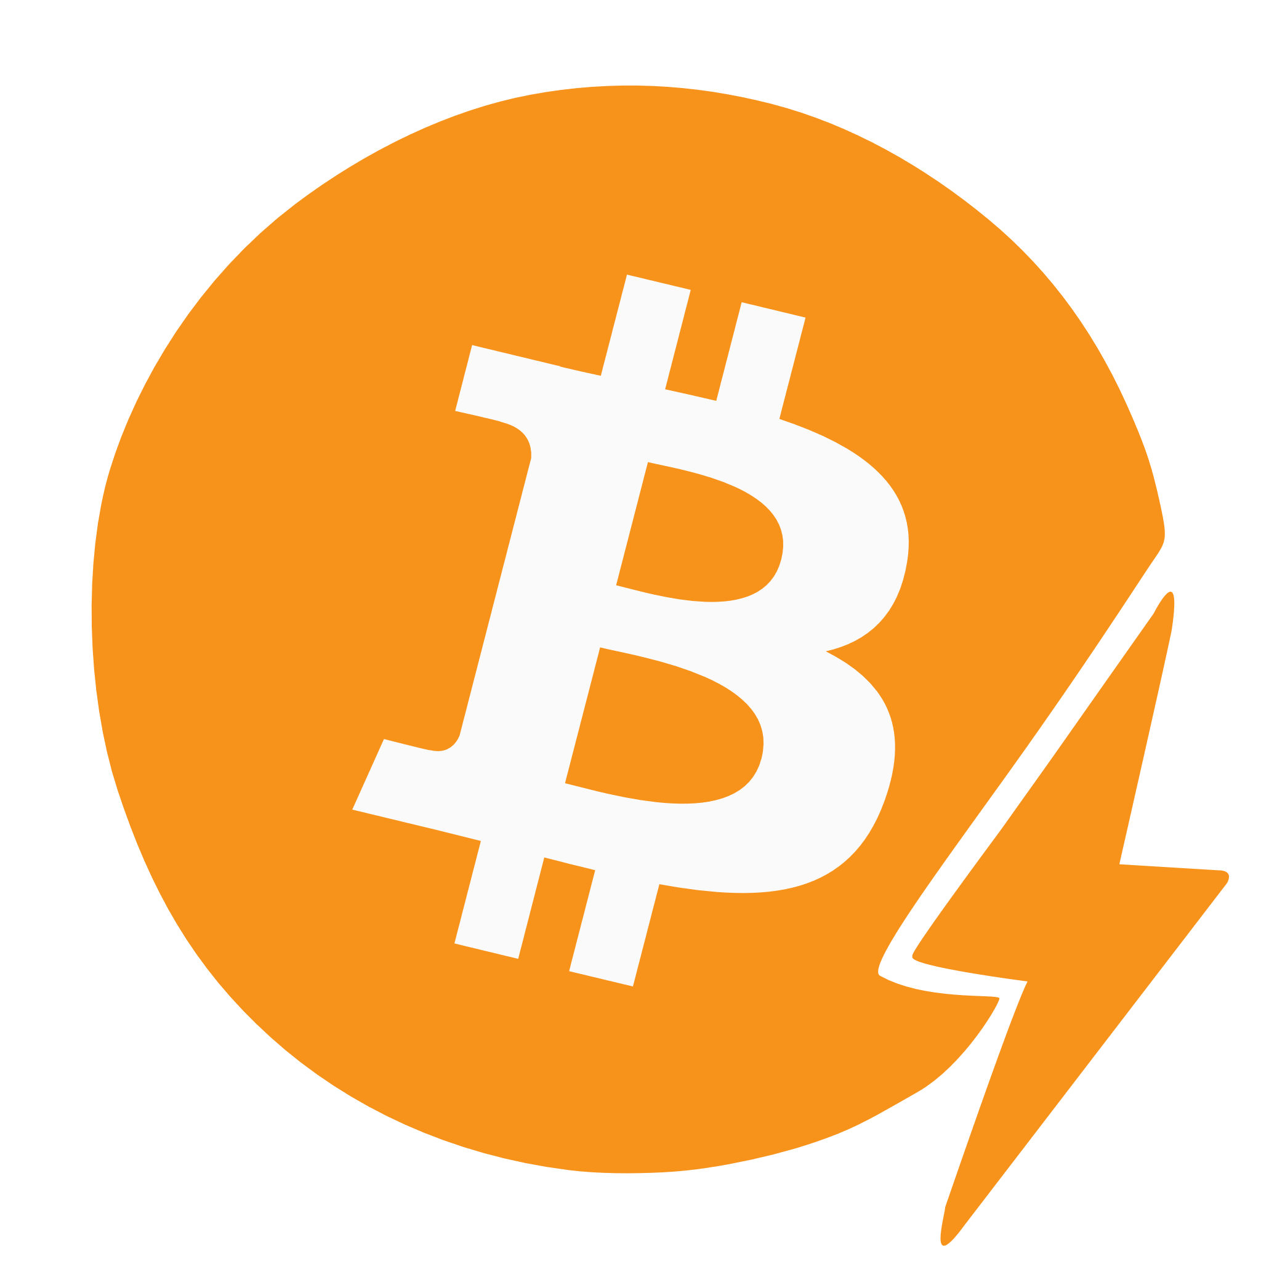
bitcoin
lightning network

